Slide 1
Installing Spark & Hadoop Tools on Windows / Cygwin / WSL / ..
Error & retries screenshots

Slide 2
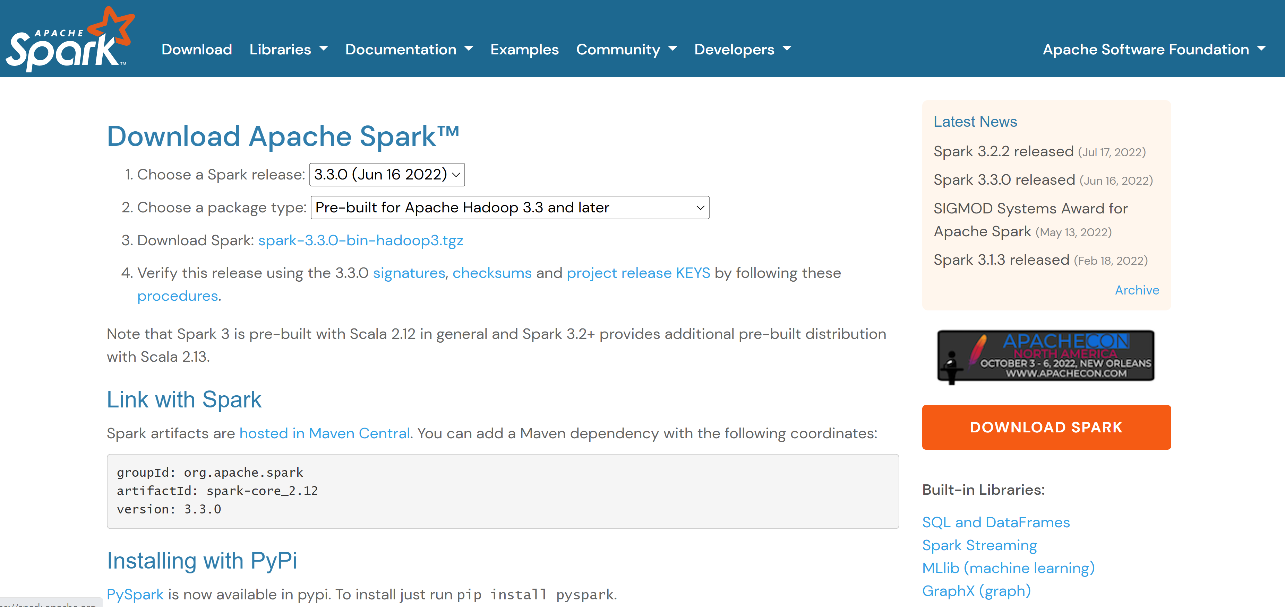
Install (Unzip) Spark
https://spark.apache.org/downloads.html

Slide 3
SPARK_HOME: Spark Unzipped Dir

Slide 4
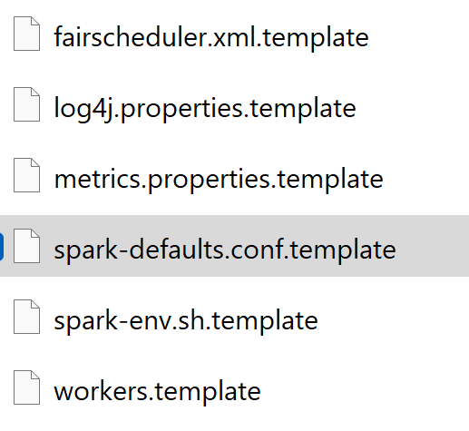
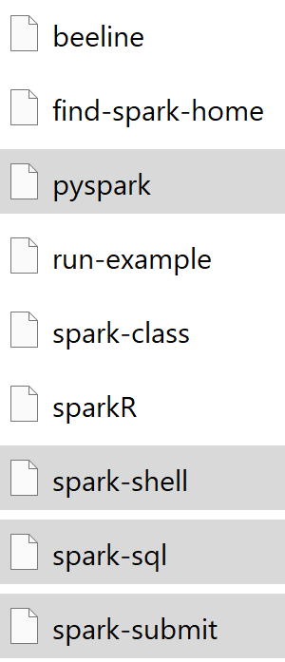
Environment variables SPARK_HOME + SPARK_CONF

Slide 6
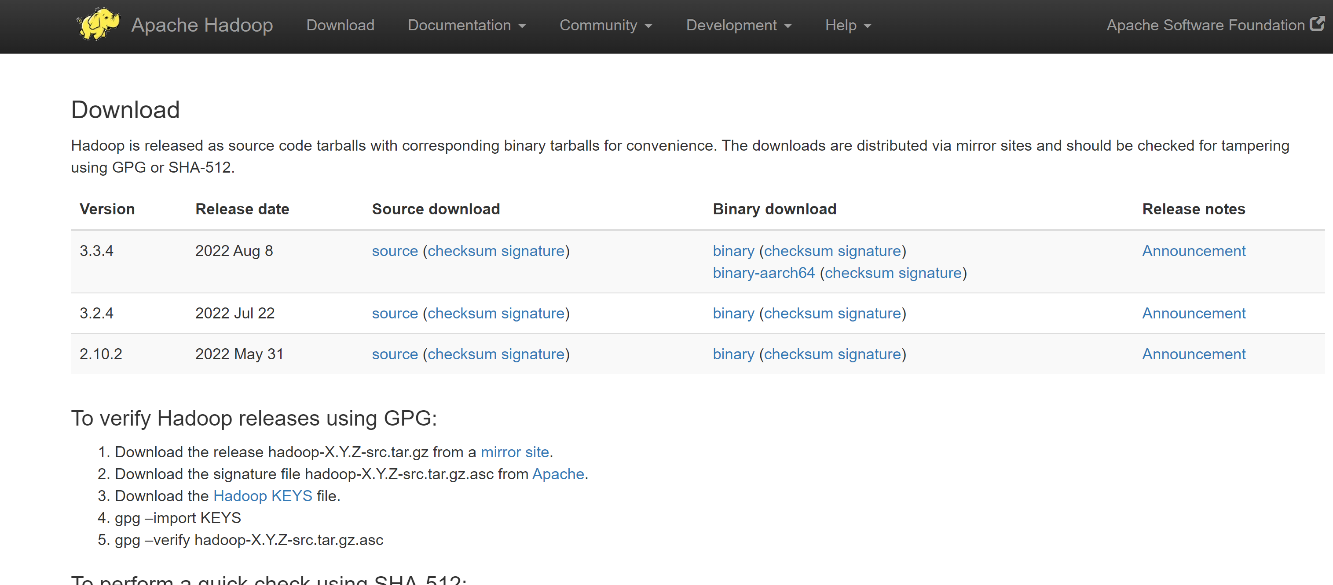
Installing HADOOP Local (no cluster)
https://hadoop.apache.org/releases.html

Slide 7
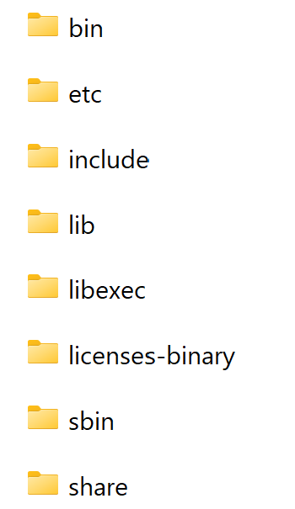
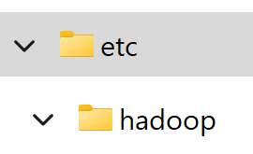
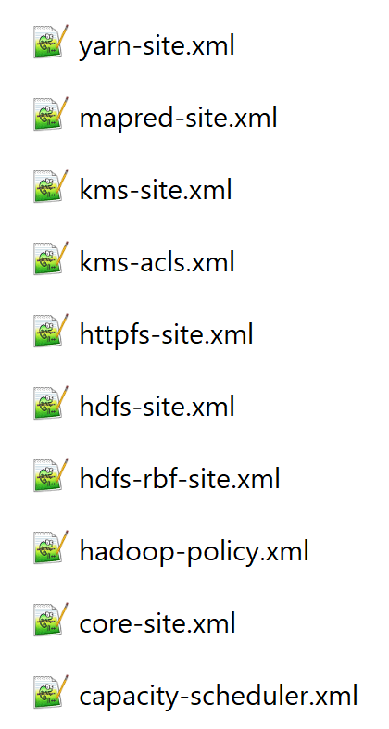
Hadoop = jar libs + winutils + hdfs + yarn + ..
Env var,
points to unzip dir
HADOOP_HOME
Unzip hadoop-3.x.x.zip
On Windows only:
Add WinUtils … dlls for « chmod », « chown »
Copy « etc » config dirs, edit
HADOOP_CONF_DIR

Slide 8
Hadoop Typical Cluster hundred of linux servers x dozen of running services
HA (Failover) Master1
HA (Failover) Master2
HDFS NameNode
HDFS NameNode
Zookeeper Cluster
Cluster Nodes
Yarn ResourceManager
Yarn ResourceManager
Oozie Server
Oozie Server
Kafka Cluster
Spark HistoryServer
Spark HistoryServer
HDFS DataNode
Hive Metastore
Hive Metastore
Ambari, Ranger, Zeppelin, Hbase, etc, etc…
Ambari, Ranger, Zeppelin, Hbase, etc, etc…
Yarn NodeManager

Slide 9
Using HortonWorks Data Platform (HDP) distribution
Notice
Fully Open-Source … backed by company, with $$$ support
HortonWorks bought by Cloudera in 2020 !
… HDP may disapear
… customer encourage to « migrate to CDP »
Packages in Azure cloud as « HD-Insight » product

Slide 10

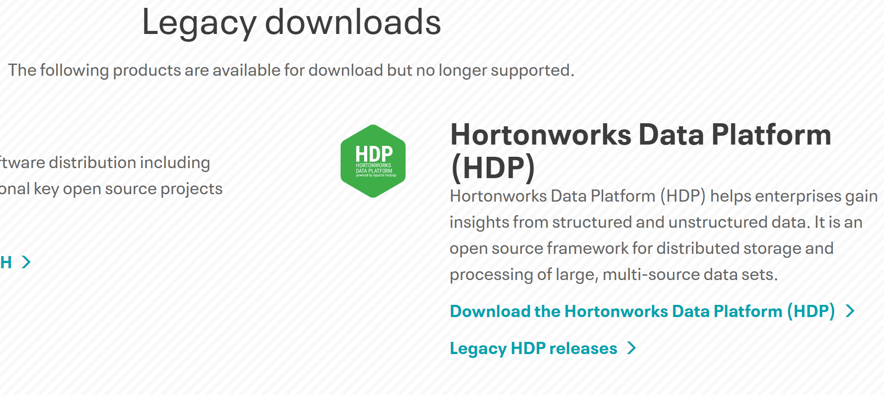
Trying HDP ?
Now need login with Cloudera Account
download as VirtualBox Images (>=800Mo)
… then VM requires >= 20Go of RAM …

Slide 11
Single Node Hadoop cluster ???
ZooKeeper
HDFS NameNode+ Embedded DataNode
Data dir
Optionnal, only for using HDFS
Yarn useless on 1 nodes only!
Hive Metastore
HiveMetastore optionnal (for SQL with named database-table
schemas)
Postgresql / mysql
Zeppelin / Jupyter
Zeppelin optionnal, but better for interactive queries
Spark Master + Spark History ?
Spark servers optionnal,
Can use spark « local[*] » mode

Slide 12
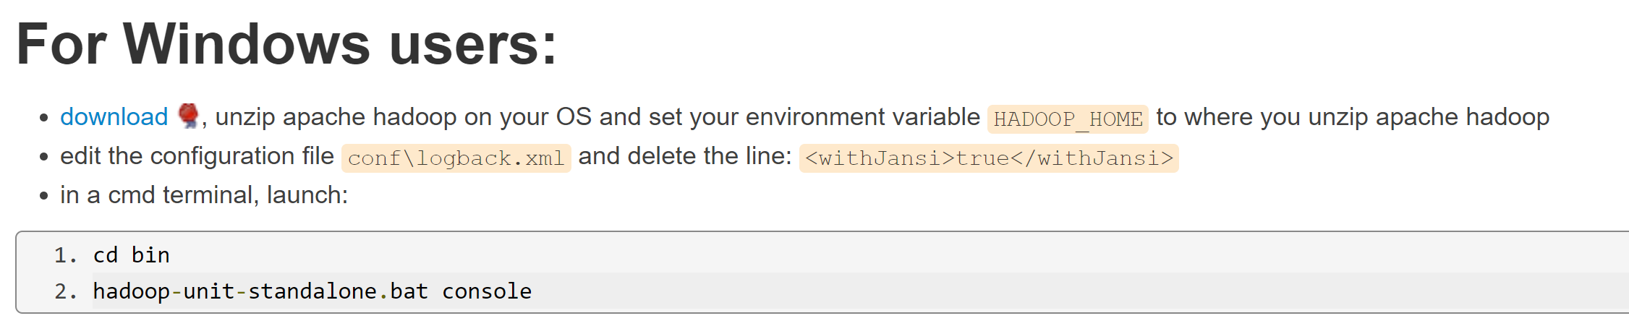
Using « HadoopUnit » ? ( for Junit tests / all-in-one embedded servers)
https://github.com/jetoile/hadoop-unit
https://blog.jetoile.fr/hadoop-unit/install-hadoop-unit-standalone.html

Slide 13
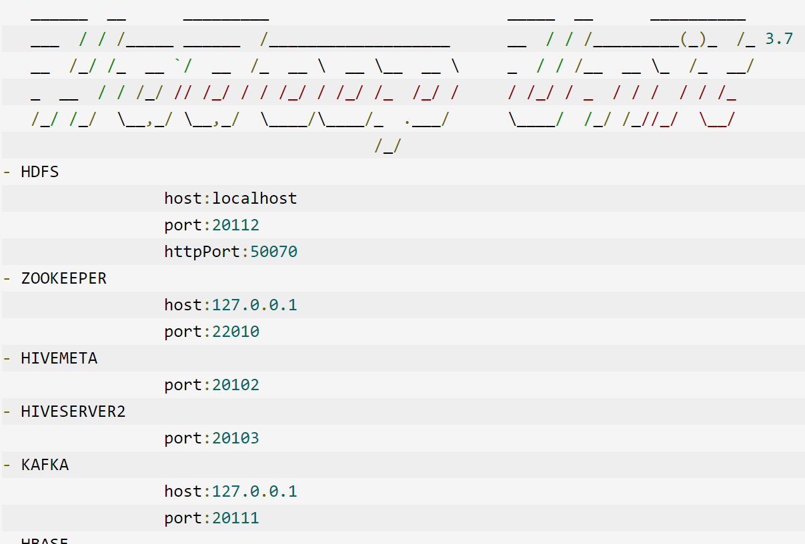
hadoop-unit-standalone console

Slide 14
Windows + Cygwin + pip

Slide 15
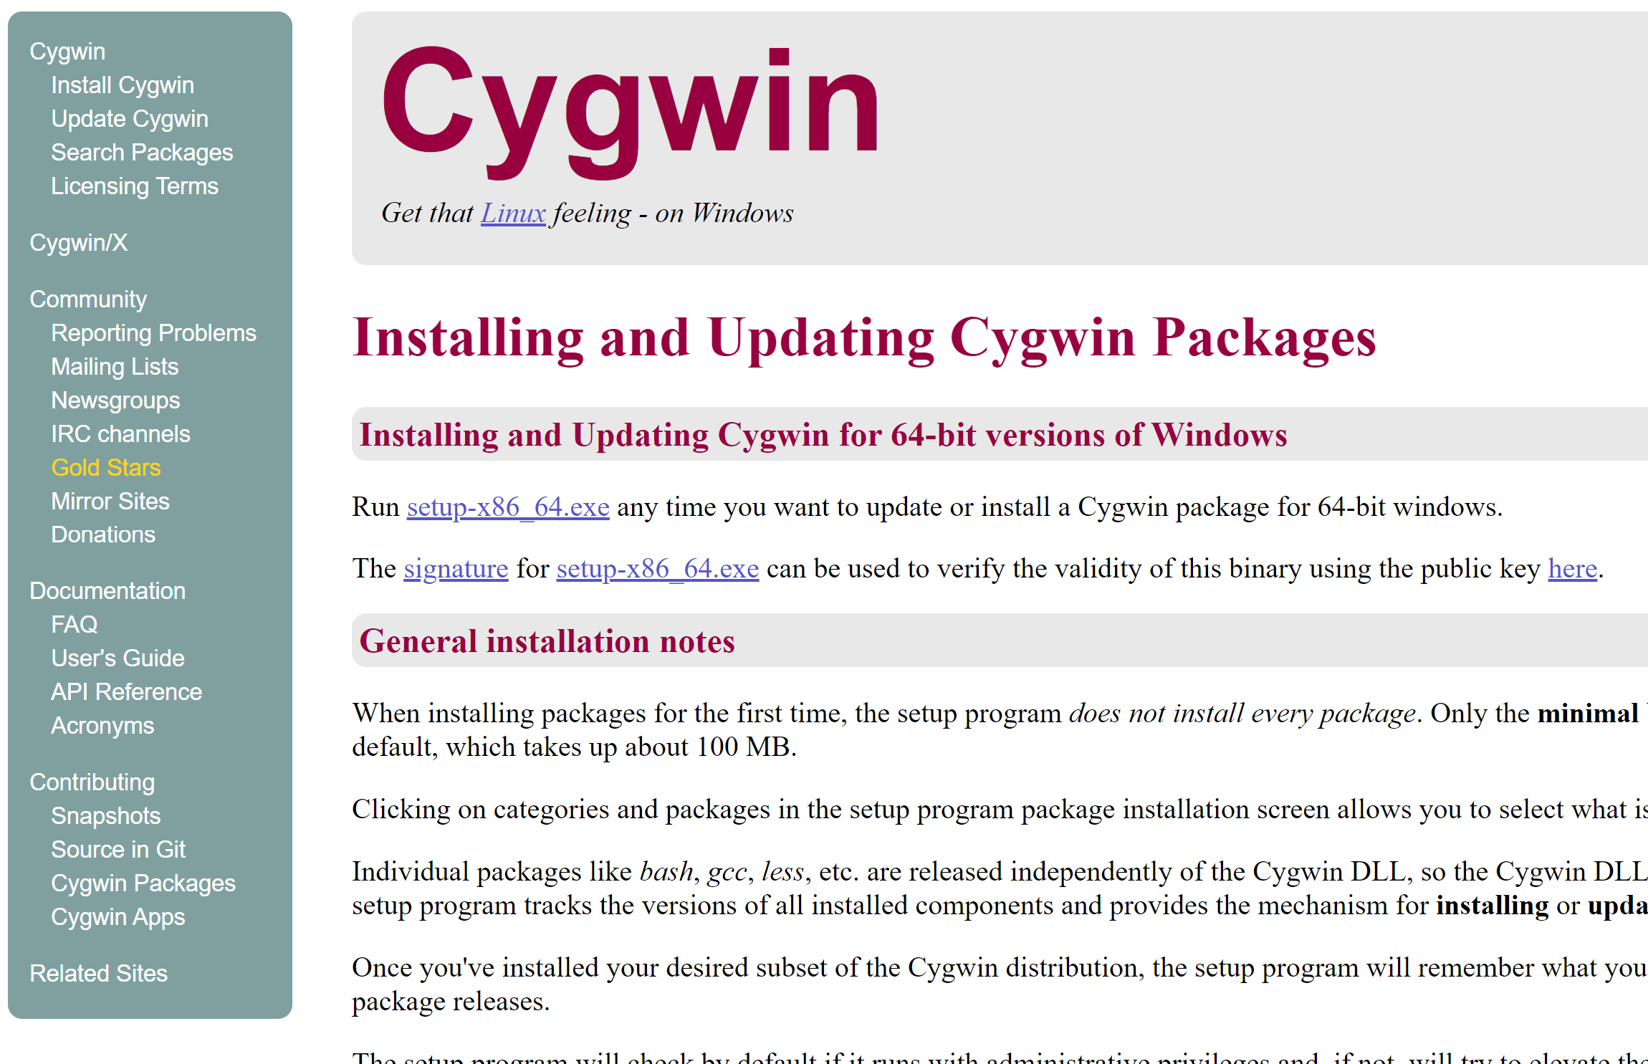
Installing Cygin
https://www.cygwin.com/install.html

Slide 16
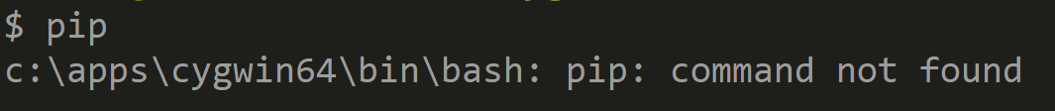
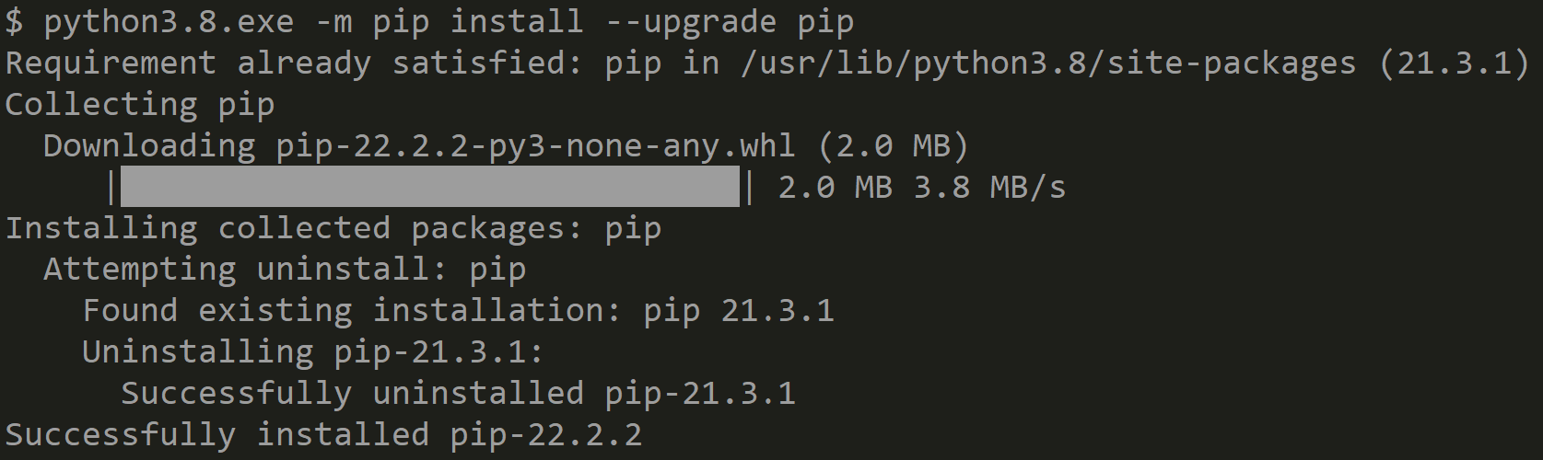
« Pip » ? « pip3 » ?
=> NO more symbolic link? …

Slide 17
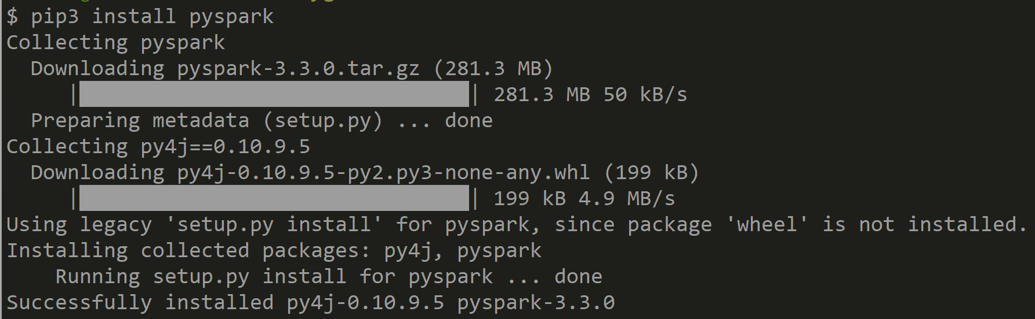
pip3 install pyspark

Slide 18
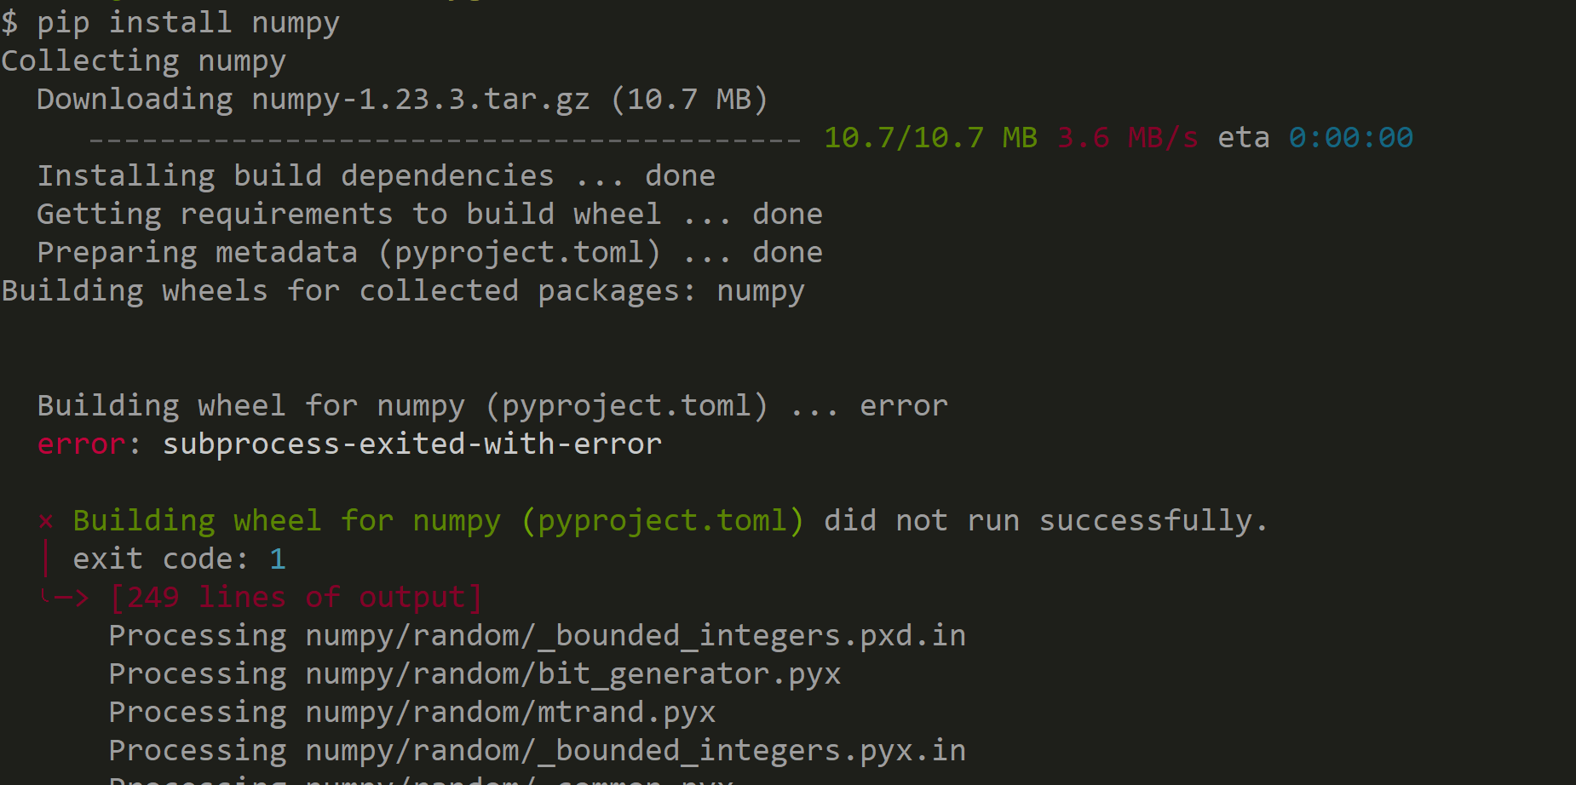
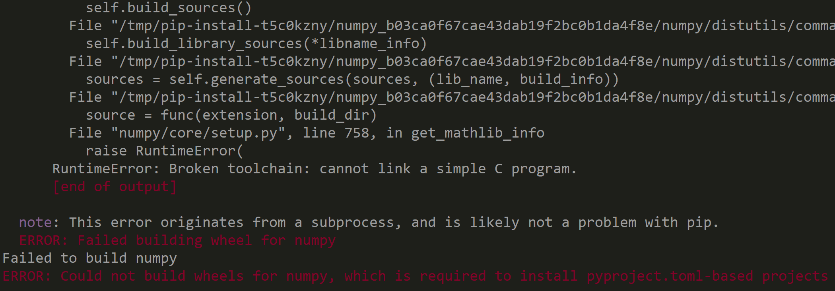
« pip install numpy » ??
FAILED .. ??!!
Failed to build « wheel »

Slide 19
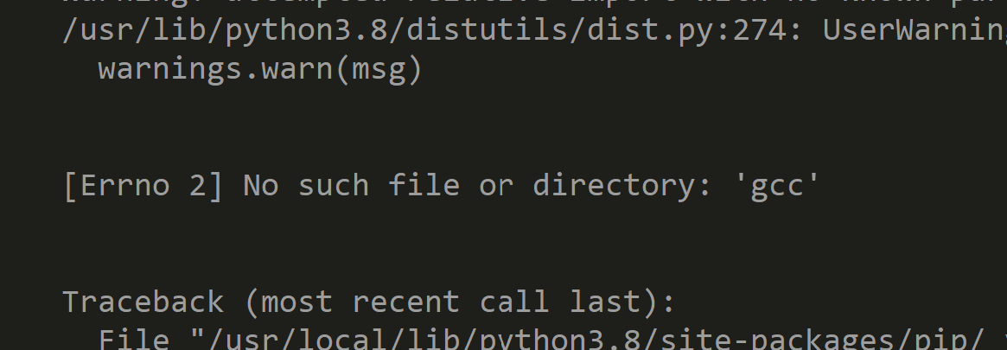
Pip fail .. Cause ?

Slide 20
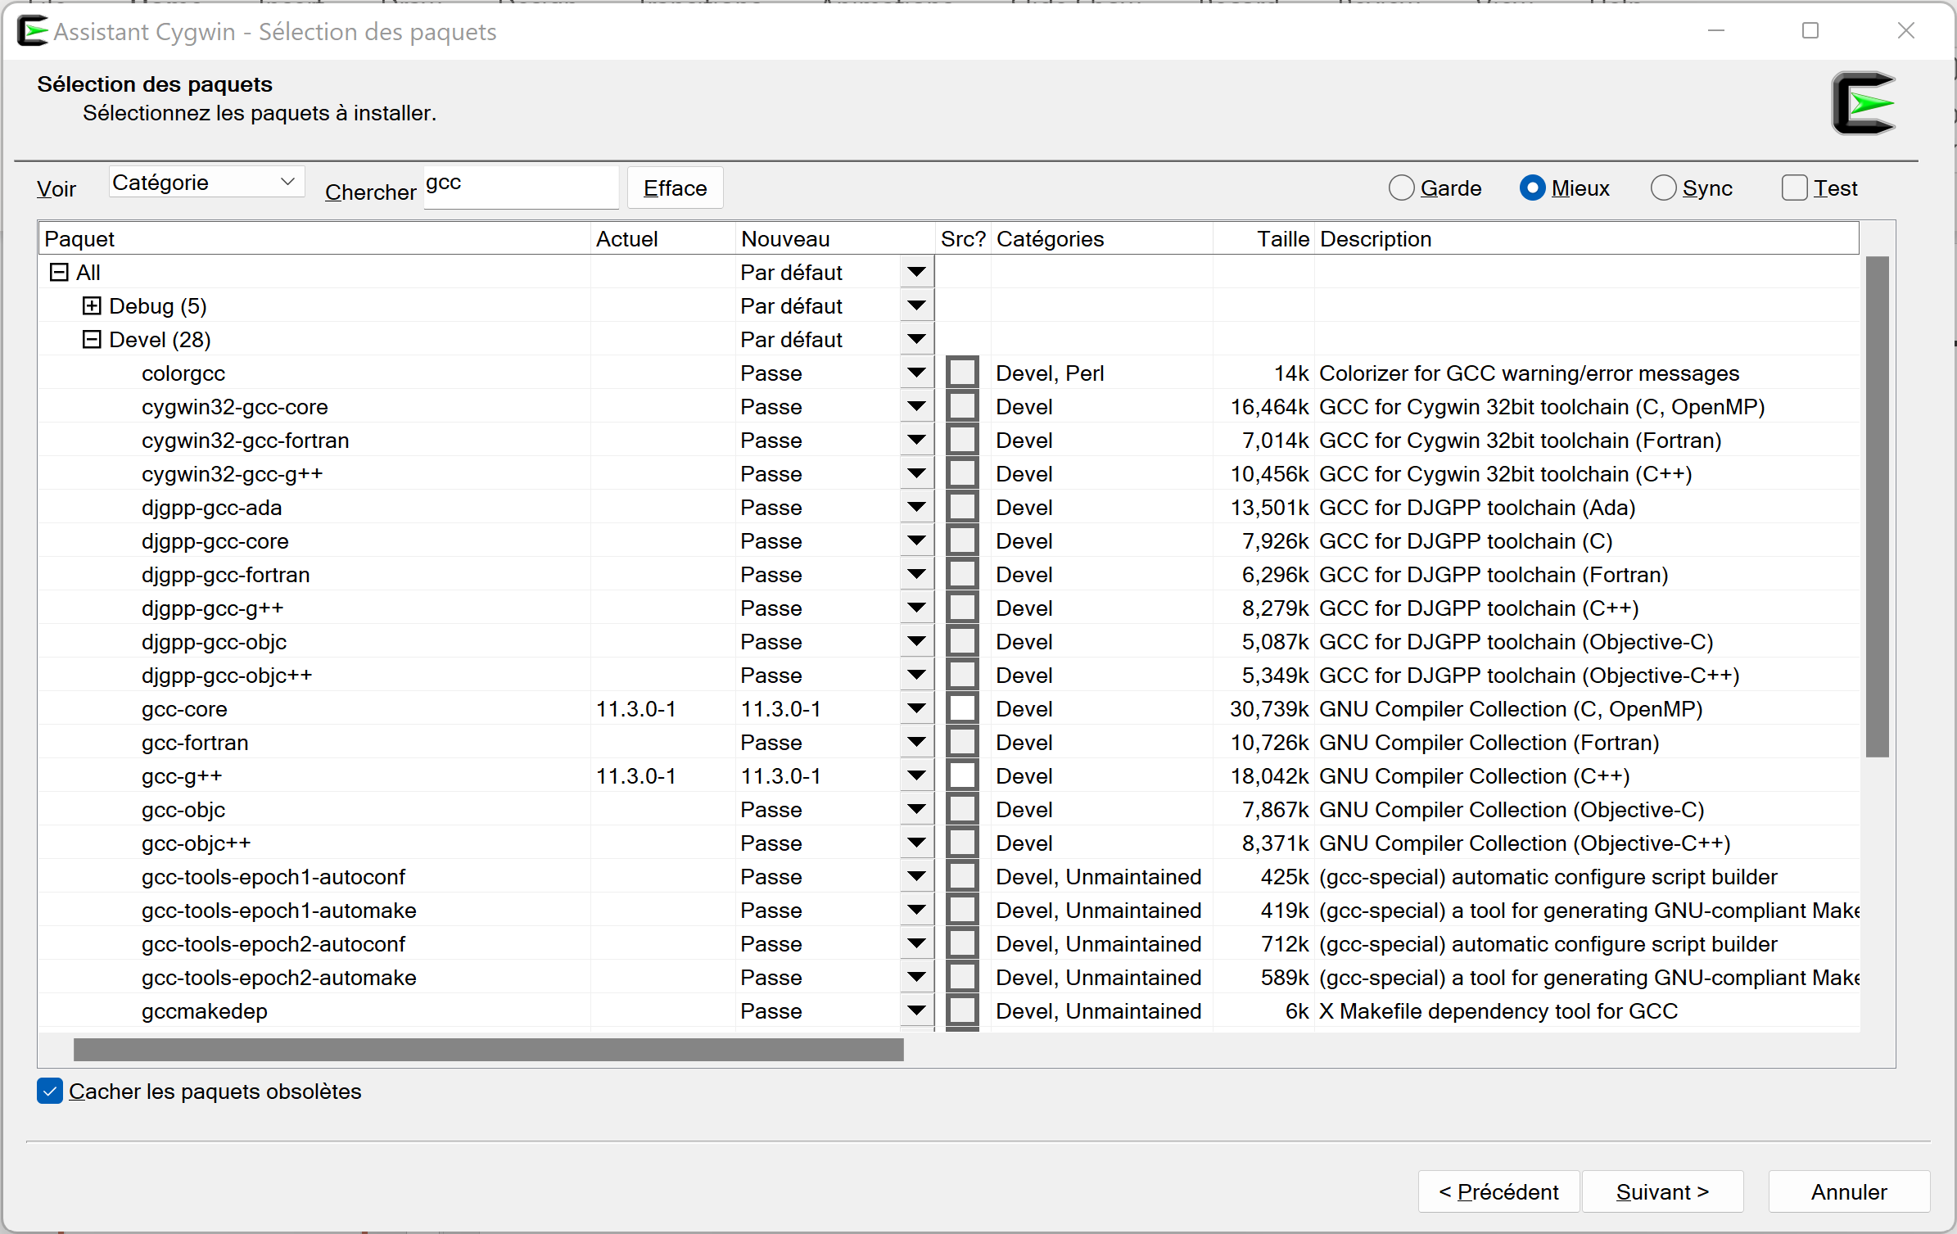
Cygwin install gcc, g++

Slide 21
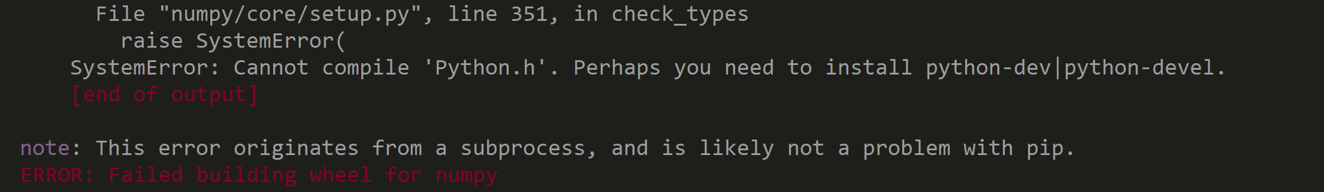
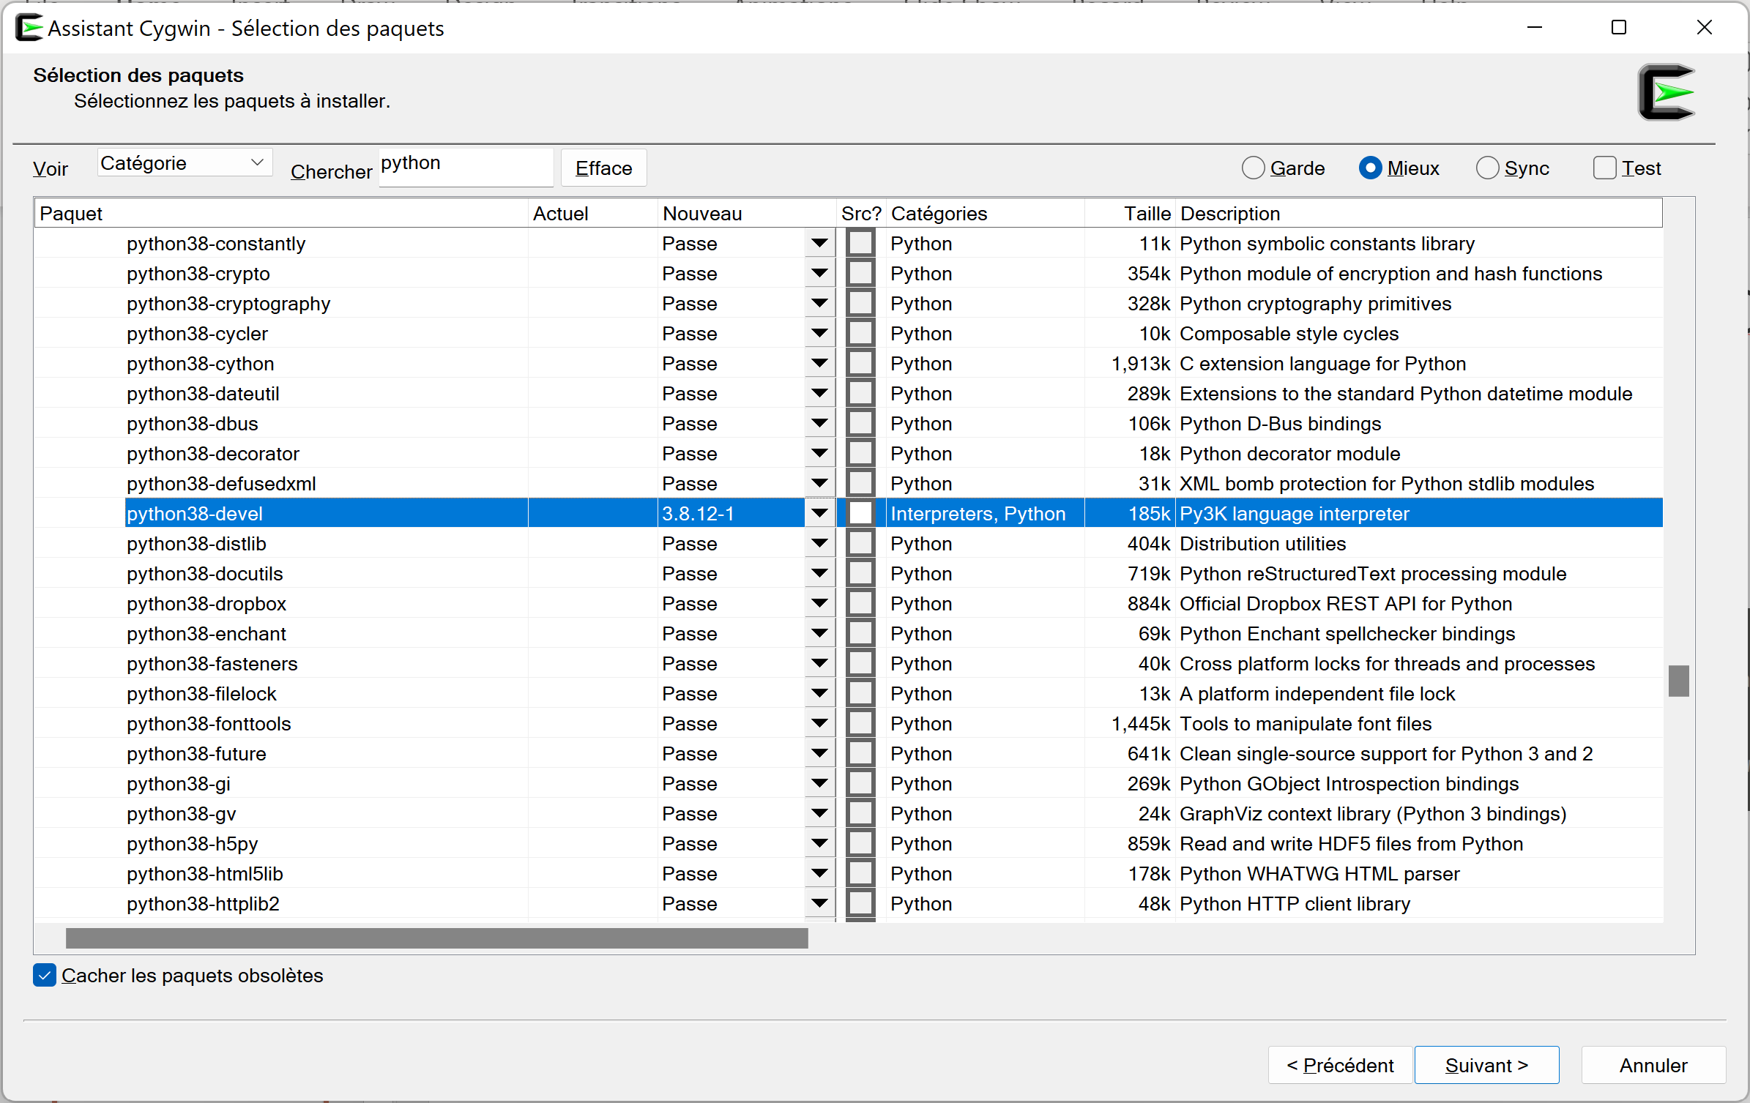
Retry install numpy .. Build wheel ..

Slide 22
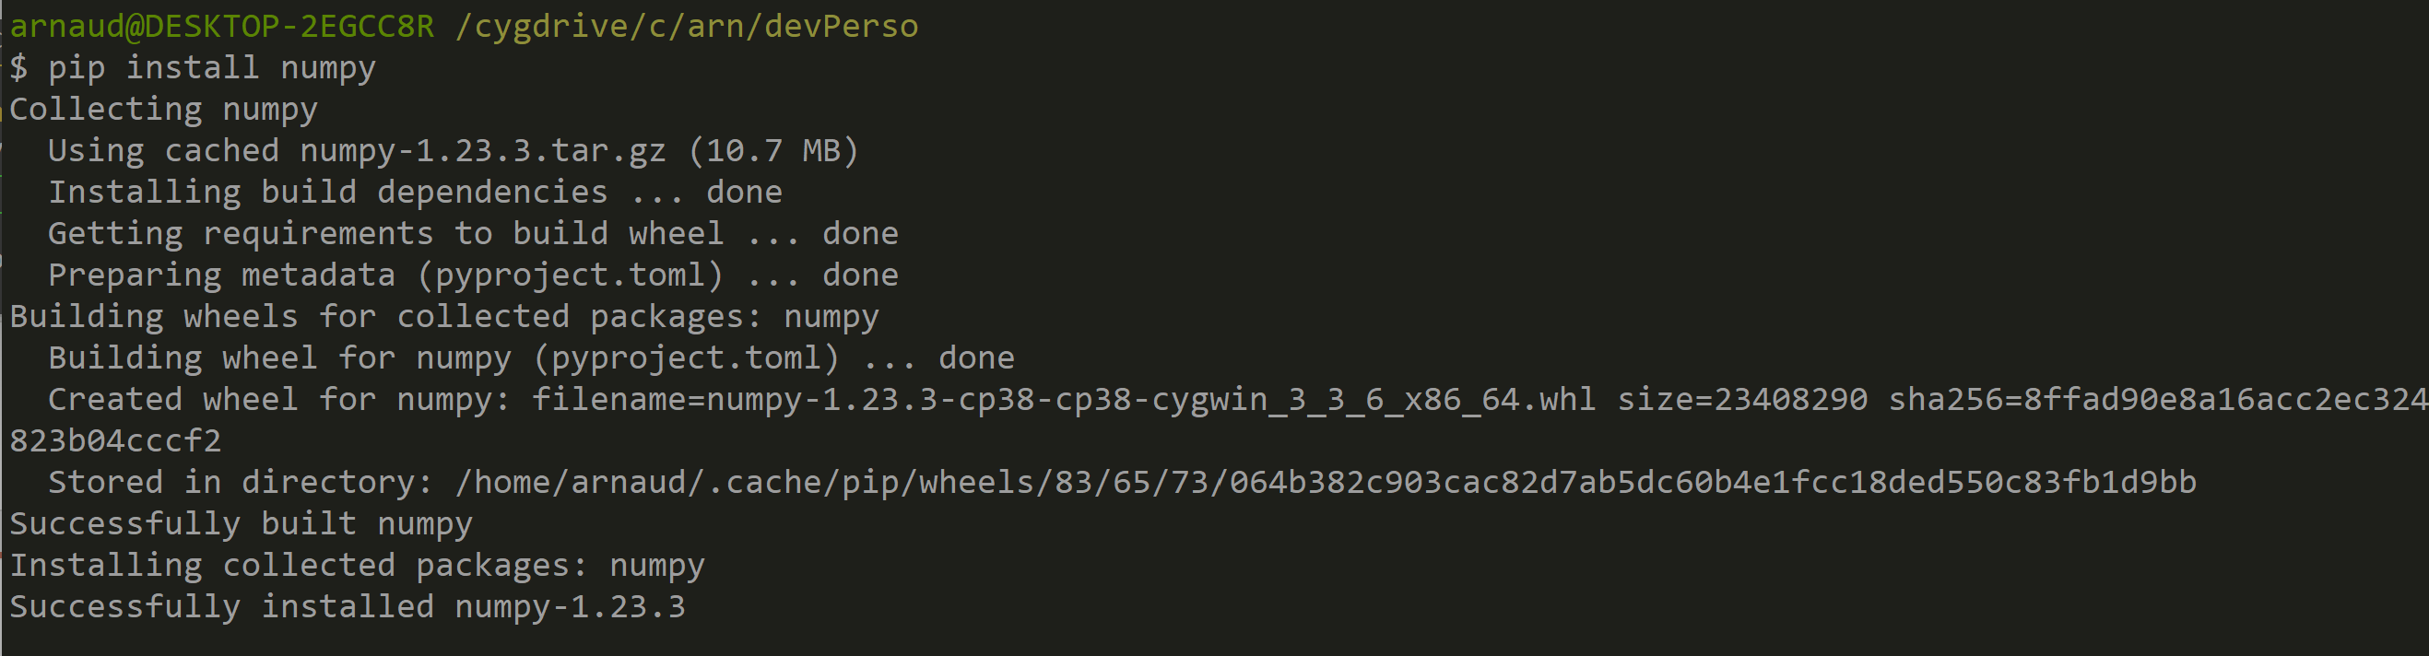
Cygwin – pip install numpy

Slide 23
Using windows WSL - Debian WSL = Windows SubSystem for Linux

Slide 24
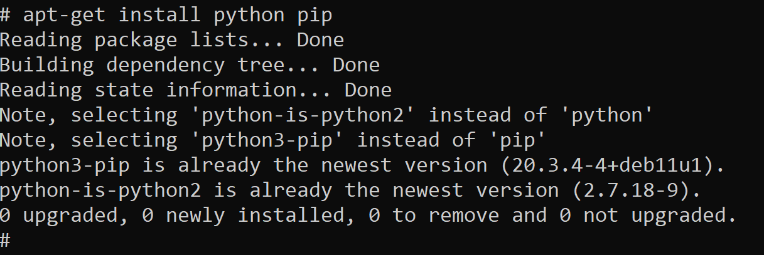
# apt-get install python pip

Slide 25
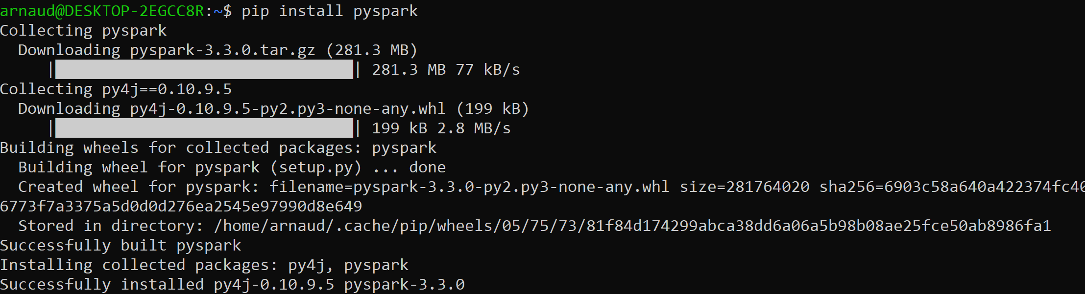
WSL – pip install pyspark

Slide 26
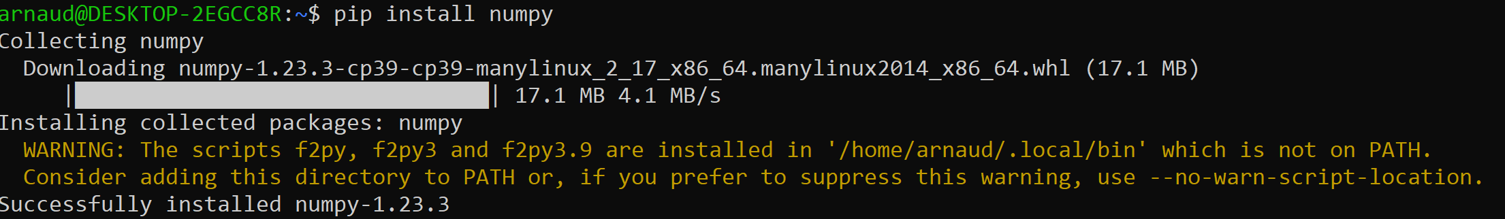
WSL – pip install numpy

Slide 27
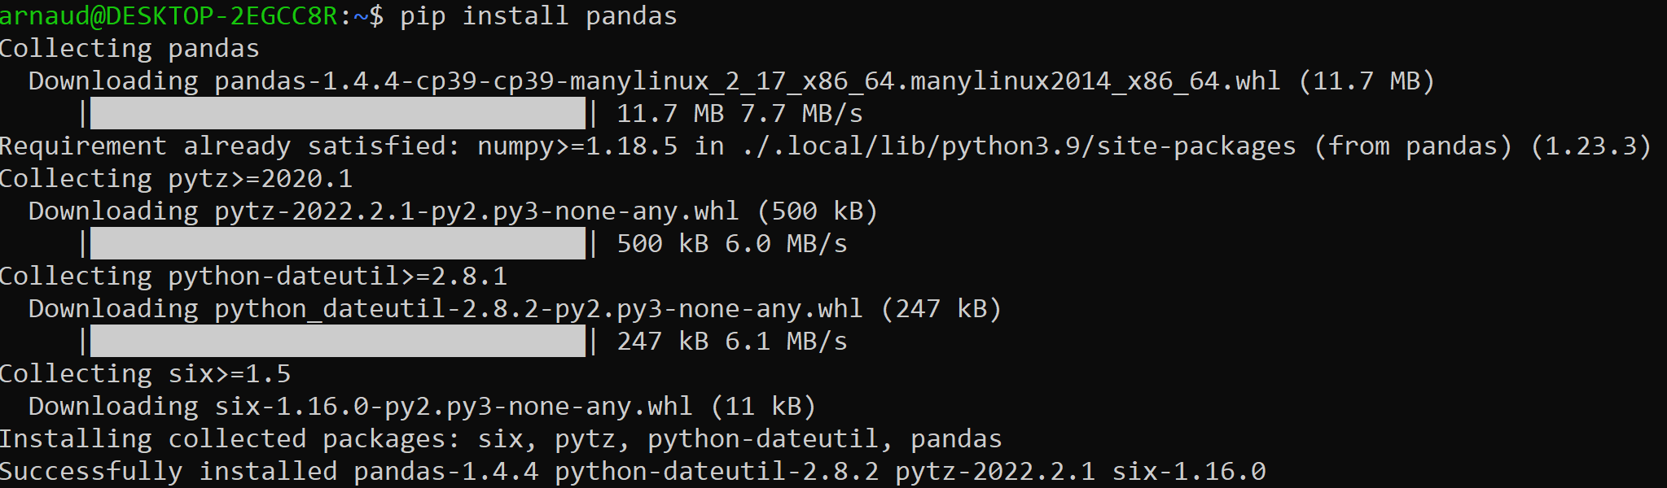
WSL – pip install pandas

Slide 28
Using Windows + Anaconda

Slide 29
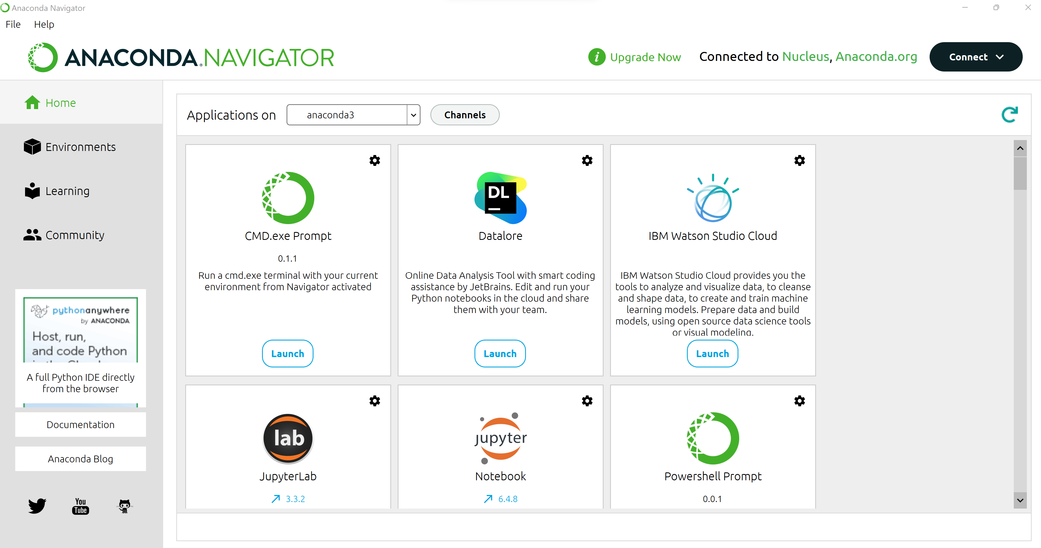
Anaconda - Home

Slide 30
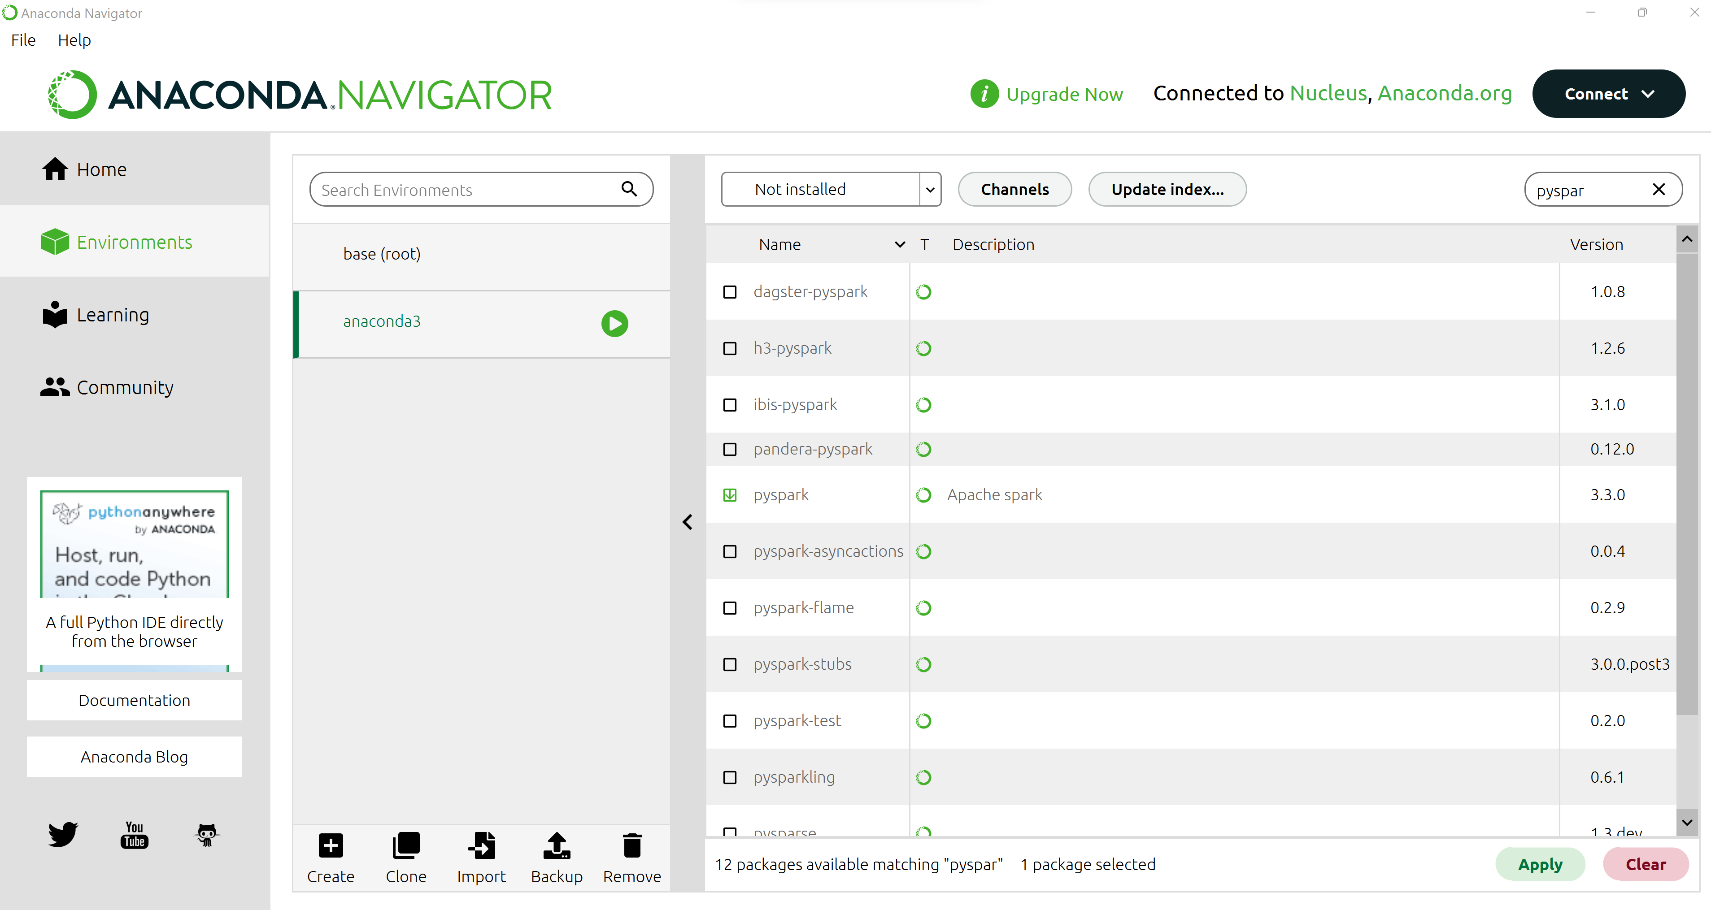
Pyspark … NOT installed by default

Slide 31
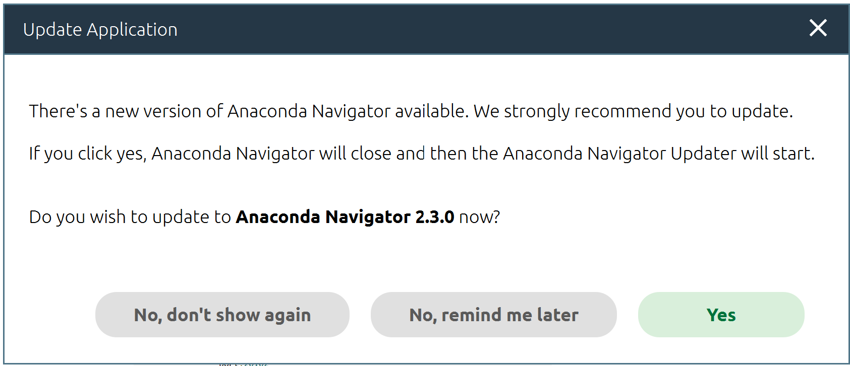
Anaconda .. Upgrade after fresh install ?

Slide 32
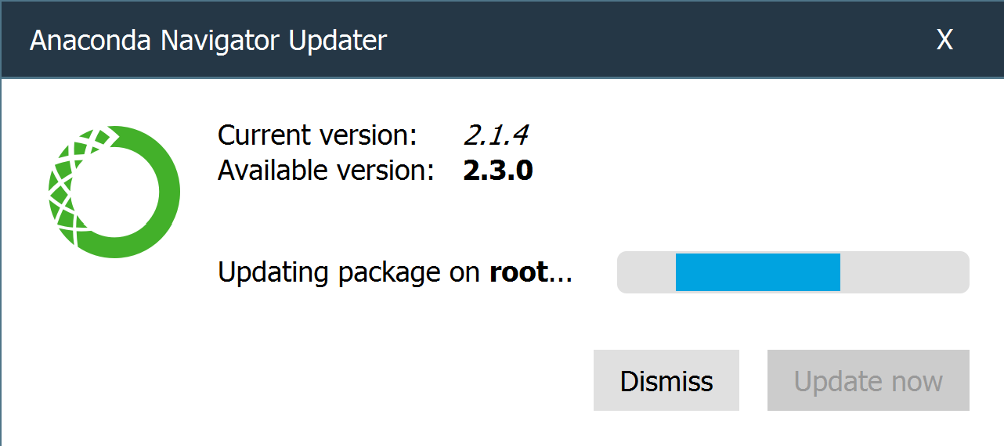
Anaconda..
3 hours later … still
Anaconda completly buggy ??? Upgrade takes >= several hours ? Or never finishing ?

Slide 33
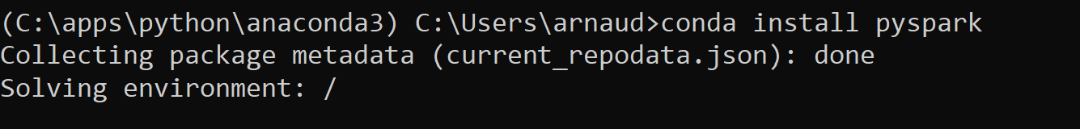
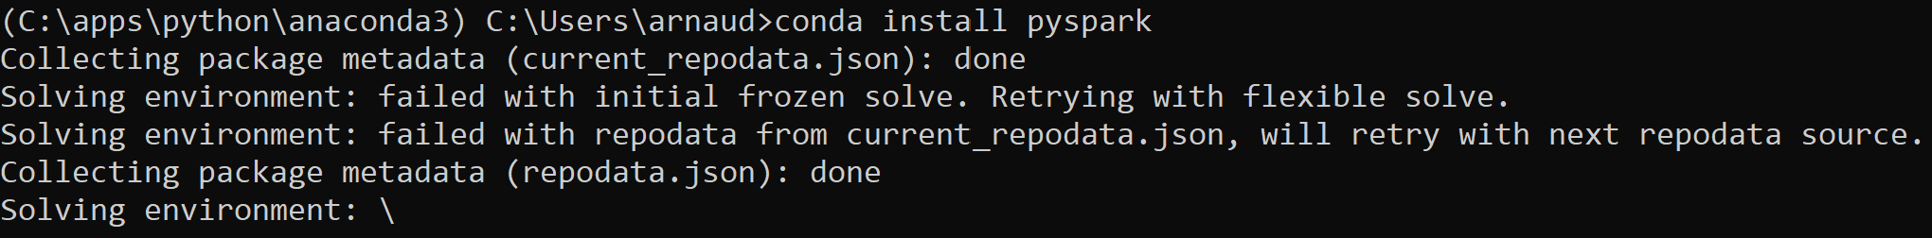
Command line conda…
Same buggy … 1 hour later..

